Slide 1
Agenda
DevOps Overview
Version Control Using GitHub or GitLab
Continuous Integration using Jenkins
Containerization using Docker
Docker management using Kubernetes
Configuration Management using Ansible or Puppet
Continuous Monitoring using Nagios

Slide 2
01 DevOps Overview

Slide 3
01 DevOps Overview
Waterfall Model
Why DevOps?
What is DevOps?
DevOps Stages
DevOps Tools
DevOps Use-Case

Slide 4
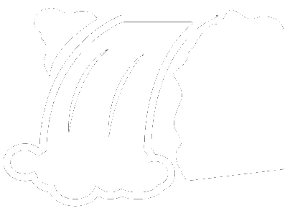
Traditional Waterfall Model
linear sequential model
one stage complete, and then next stage
Requirement Gathering
System Design
Implementation
Testing
Deployment
Maintenance
Notes:
Looks perfect, but many issues

Slide 5
Limitations of Waterfall Model
High amounts of risk and uncertainty
No working software is produced until late during the life cycle.
Once an application is in the testing stage, it is very difficult to go back and change something that was not well-thought out in the concept stage.
Not a good model for complex and object-oriented projects.
Not suitable for the projects where requirements are at a moderate to high risk of changing.

Slide 6
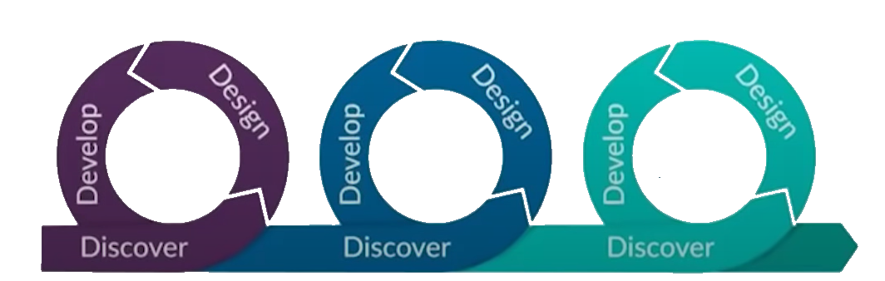
What is Agile Methodology?
In the Agile Methodology each project is broken up into several 'Iterations'
All Iterations should be of the same time duration (between 2 to 8 weeks)
At the end of each iteration, a working product should be delivered
First
Iteration
Second
Iteration
Third
Iteration

Slide 7
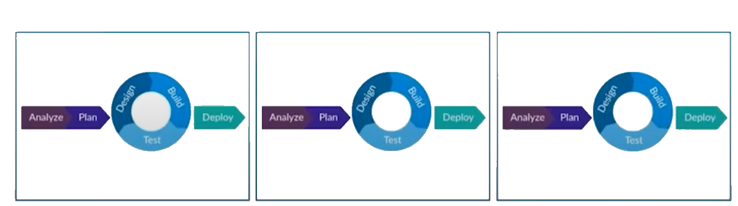
Waterfall vs Agile

Slide 8
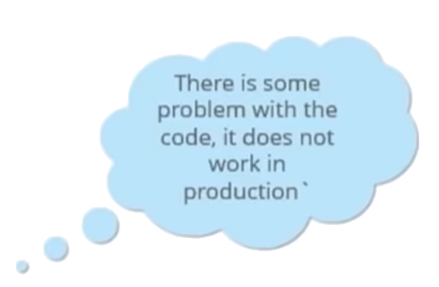
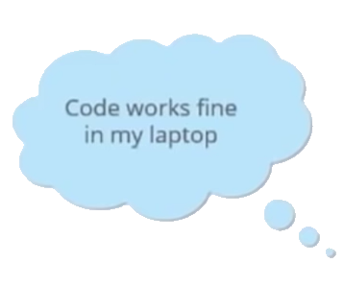

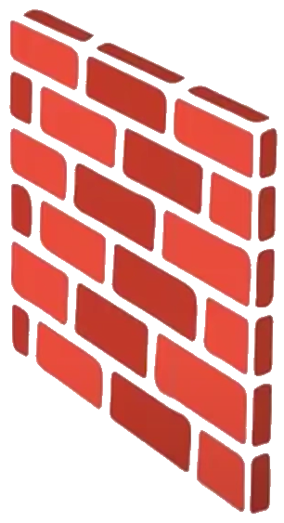

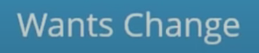
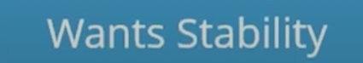
Limitations of Agile
DEVELOP TEAM
OPERATION TEAM

Slide 9
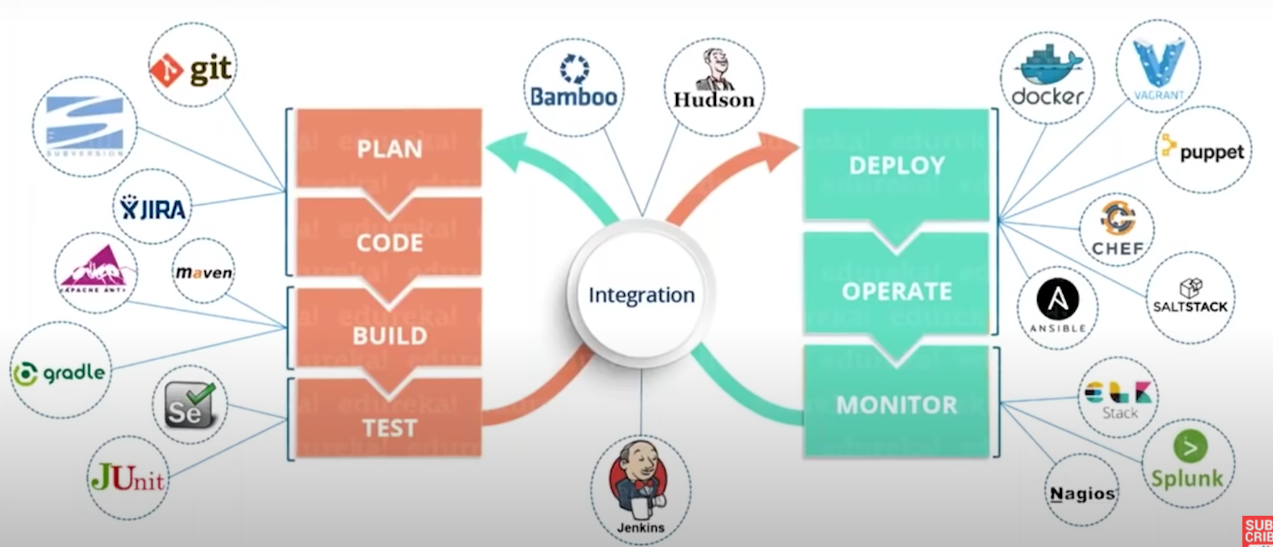
What is DevOps?

Slide 10
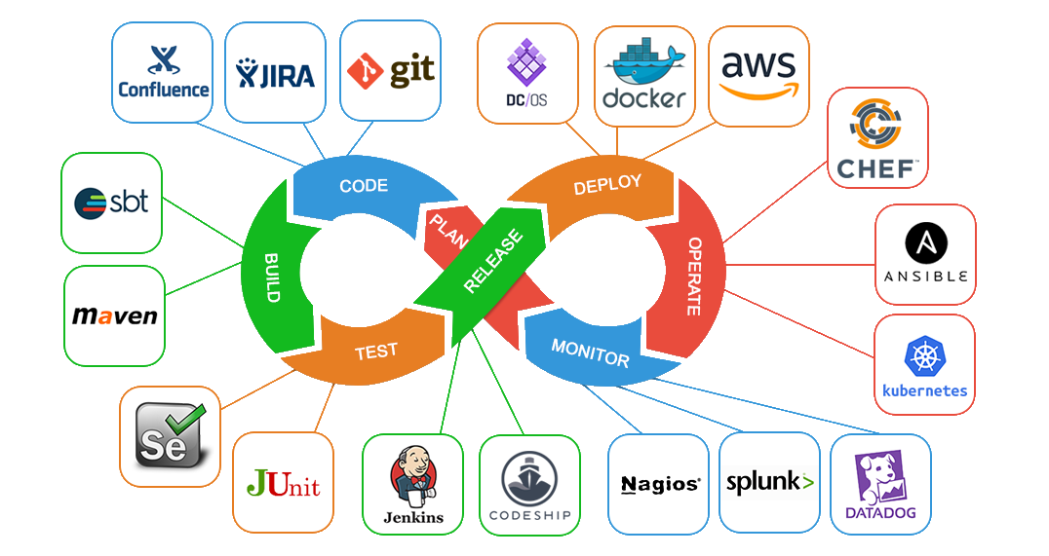
What is DevOps?

Slide 11
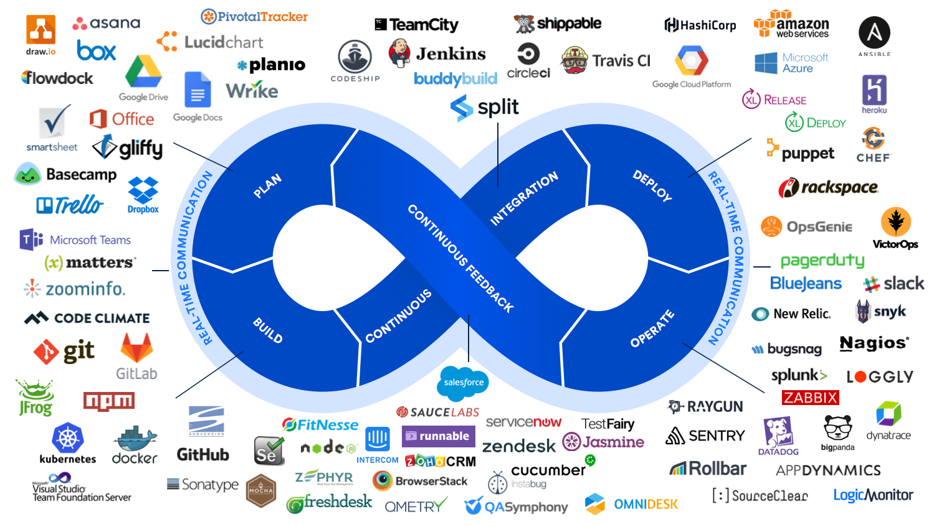
What is DevOps?

Slide 12
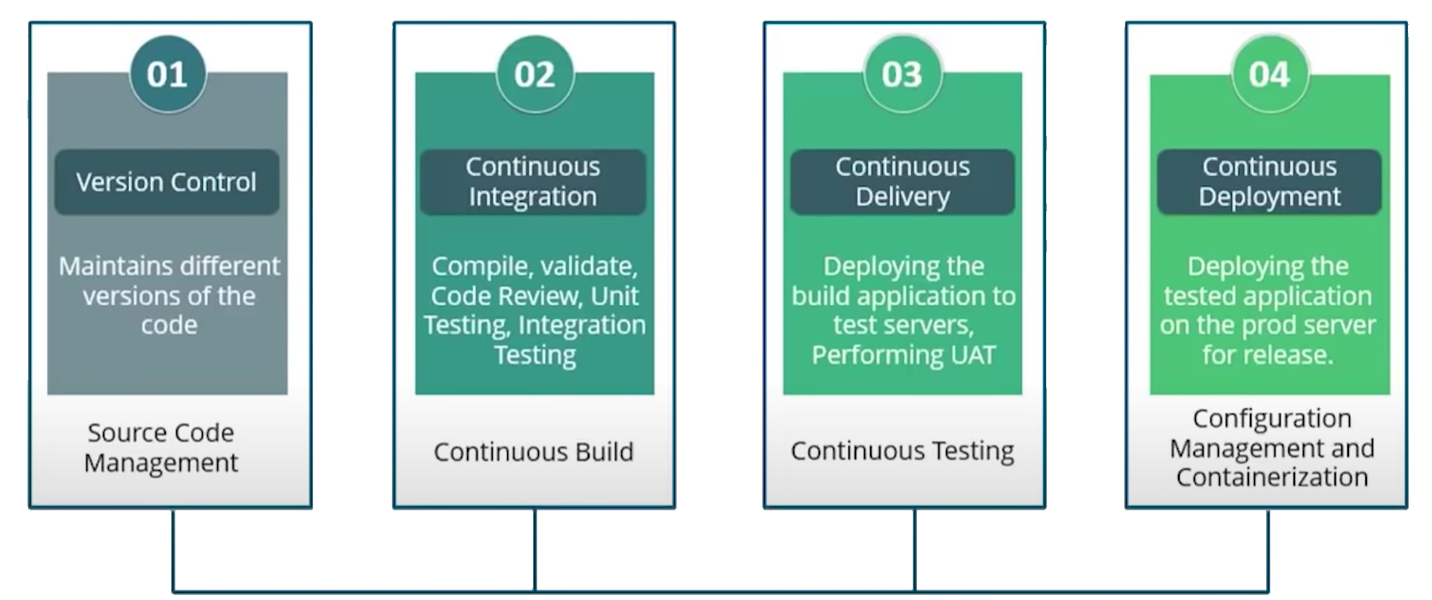
DevOps Stages
Continuous Monitoring

Slide 13
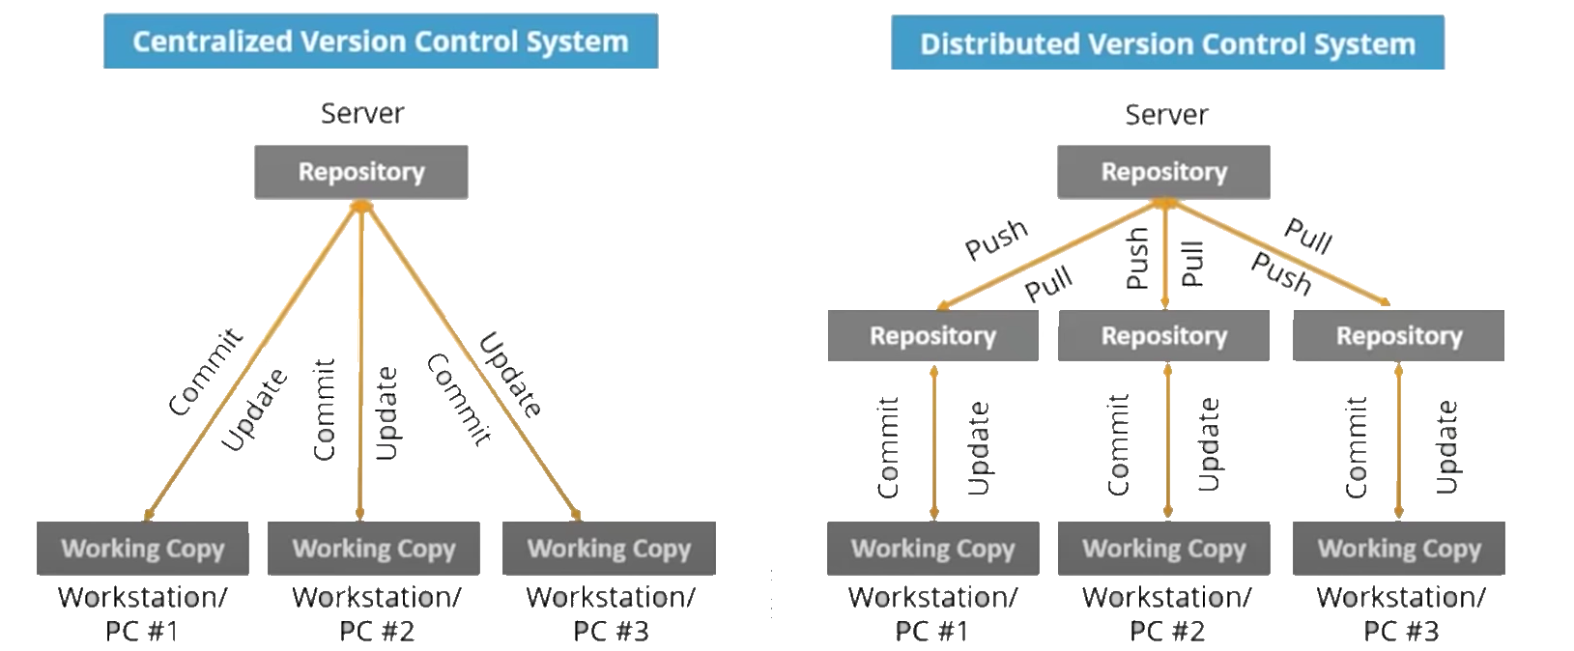
Source Code Management

Slide 14
Download and install Git
Git bash interface
Basic Git commands
Create a local repository
Connect to remote repository
Push the file to GitHub
Notes:
https://youtu.be/2j7fD92g-gE

Slide 15
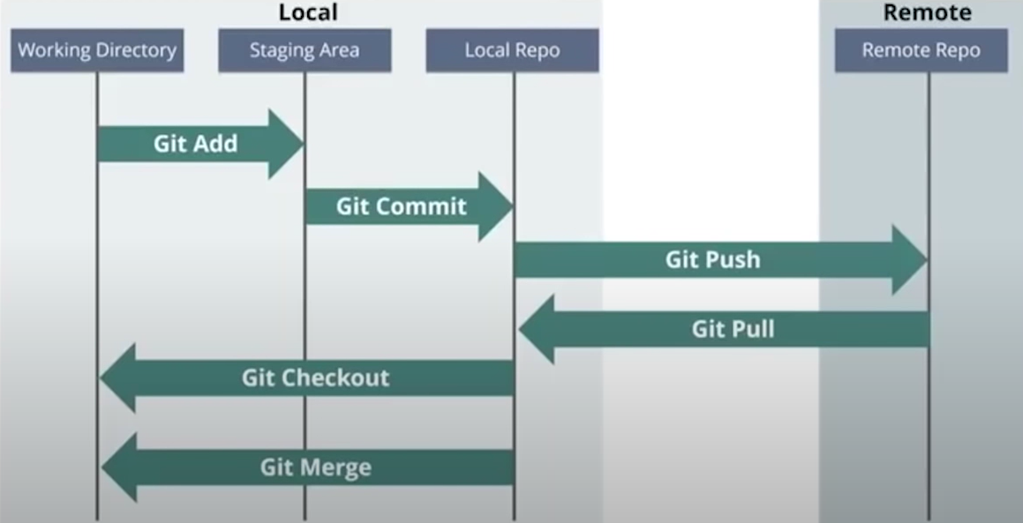
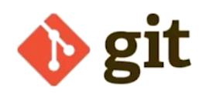
Source Code Management
Local
Remote
Working Directory
Staging
Local Repo
Remote Repo
Gid Add
Git Commit
Git Push
Git Pull
Git Checkout
Git Merge

Slide 16
Source Code Management
Working Directory
Staging

Slide 17
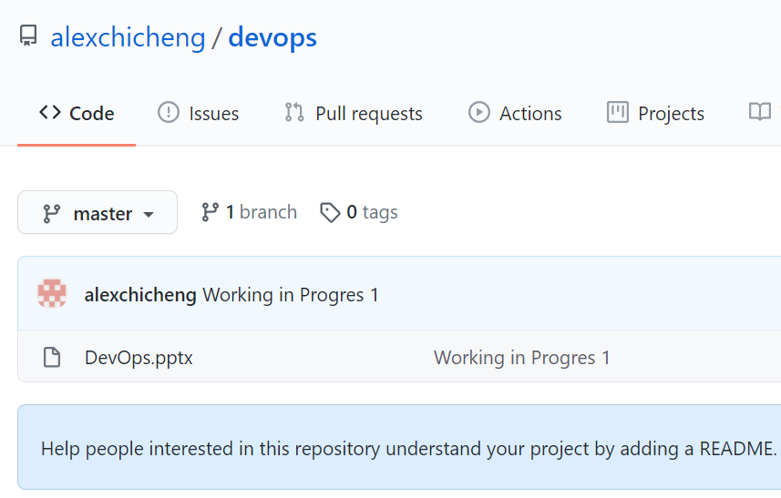
GitHub Demo Video (future)
C:\>git --version
C:\>git help config
C:\>cd C: \DevOps
C:\DevOps>git init
C:\DevOps>git status
C:\DevOps>git add DevOps.pptx
C:\DevOps>git config --global user.email "alexchicheng@gmail.com"
C:\DevOps>git config --global user.name alexchicheng
C:\DevOps>git commit -m "working in progress 1"
C:\DevOps>git remote add origin https://github.com/alexchicheng/devops.git
C:\DevOps>git push origin master
info: please complete authentication in your browser...
Enumerating objects: 3, done.
Counting objects: 100% (3/3), done.
Delta compression using up to 8 threads
Compressing objects: 100% (2/2), done.
Writing objects: 100% (3/3), 5.64 MiB | 851.00 KiB/s, done.
Total 3 (delta 0), reused 0 (delta 0), pack-reused 0
To https://github.com/alexchicheng/devops.git
* [new branch] master -> master

Slide 18

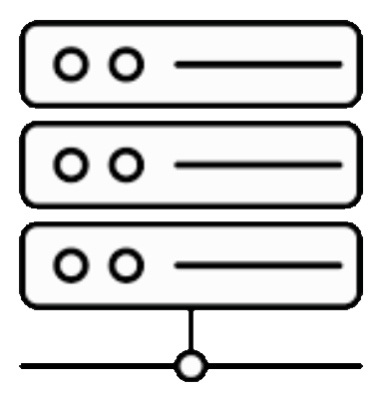
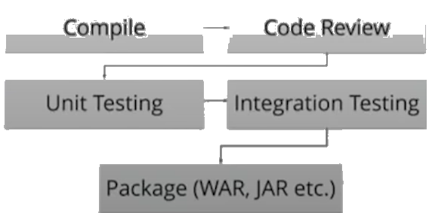
Continuous Integration

Slide 19

devops

Slide 20
Agenda
Background
Waterfall Model
Agile Model
DevOps Model
DevOps Benefits
Case Studies
Tools to Use
Demo Lab (phase II)
Demo Video (phone II)

Slide 21
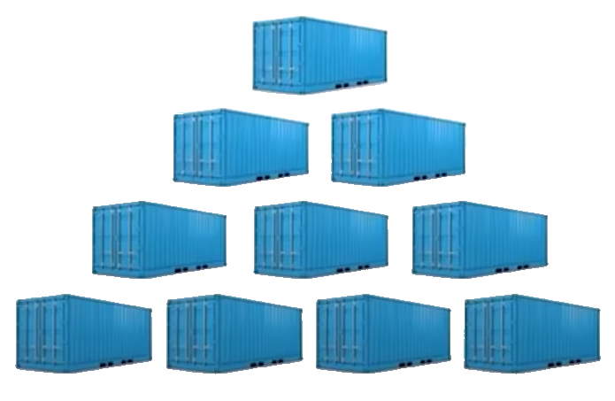

Slide 22
Features Of Kubernetes
Automatic Binpacking
Service Discovery &
Load Balancing
Storage Orchestration
Self Healing
Batch Execution
Horizontal Scaling
Secret & Configuration Management
Automatic Rollbacks & Rollouts

Slide 23
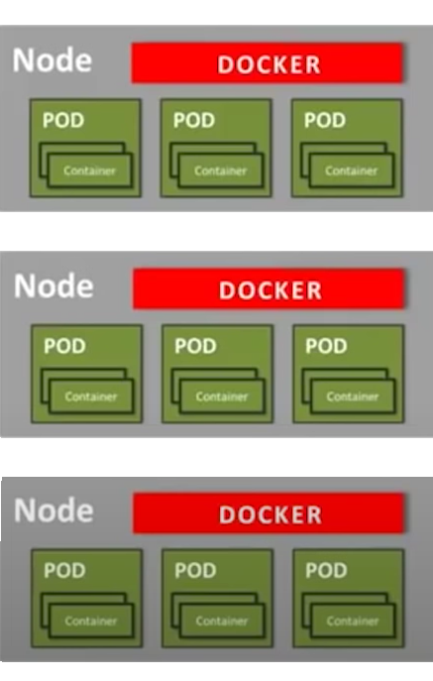
Working Of Kubernetes
Master controls the cluster; and the nodes in it
Nodes host the containers inside them; Containers are inside separate PODS
PODS are logical collection of containers which need to interact with each other for an Application
Replication Controller is Master's resource to ensure that requested nt&of pods are running on nodes always
Service is an object on Master that provides loadbalancing across a replicated group of PODS
Kubernetes
Master

Slide 24
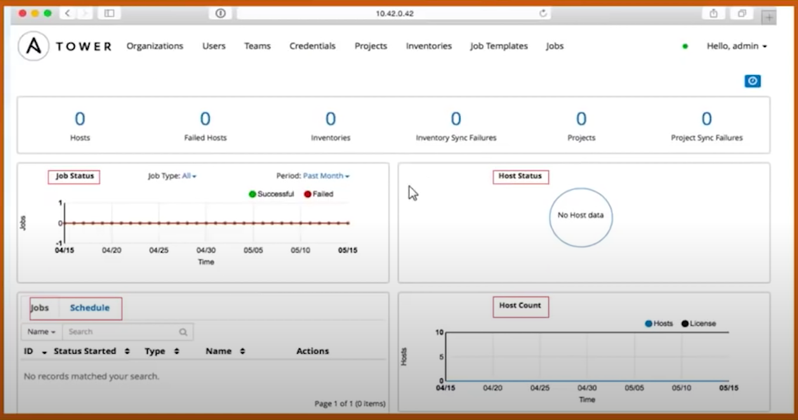
Ansible Tower Dashboard
Provided status summary of all jobs
Divided organization into groups to manage access permissions

Slide 25
Configuration Management
Why Configuration Management
What is Configuration Management
Management tools
Puppet Architecture
Configuration
Demo Video (future)

Slide 26
Puppet is a Configuration Management tool that is used for
deploying,
configuring and
managing servers.
It uses a Master-Slave architecture.

Slide 27
Waterfall model
Development go to next phase
Notes:
https://youtu.be/hQcFE0RD0cQ

Slide 28
Git hub demo

Slide 29
Need for Kubernetes
What exactly it is & what its not?
How does Kubernetes work?
Use-Case: Kubernetes @ Pokemon Go
Hands-on: Deployment with Kubernetes

Slide 30
Git lab demo

Slide 31
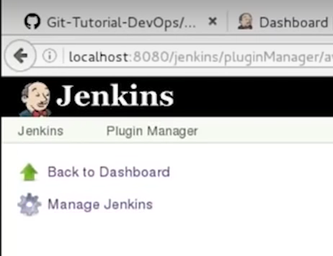
demo

Slide 33
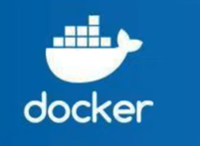

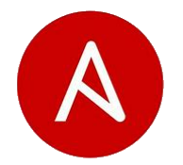
Demo Lab Container Based Framework
GIT Lab
(Private Server)
Developer
FSI Demo Code Modules
New code
Ansible
Docker

